Slide 1
Labeling of Topic Models Using Text Summaries
2016 ACL
1

Slide 2
1
Motivation
Providing more contextual information and using long text descriptions to represent the topics
the top terms for a discovered topic:
fire miles area north southern people coast
homes south damage northern river state friday
central water rain high california weather

Slide 3
1
Motivation
Providing more contextual information and using long text descriptions to represent the topics
Showers and thunderstorms developed in parched areas of the southeast , from western north carolina into south central alabama , north central and northeast texas and the central and southern gulf coast . … The quake was felt over a large area , extending from santa rosa , about 60 miles north of san francisco , to the santa cruz area 70 miles to the south ….

Slide 4
2
Contributions
We are the first to invesitage using text summaries for topic labeling
We propose a summarization algorithm based on submodular optimization to extract summaries with both high relevance, coverage and discrimination for all topics
Automatic and manual analysis reveals the usefulness and advantages

Slide 5

3
Methods
Candidate Sentence Selection
Computing the Kullback-Leibler (KL) divergence between the word distributions of the topic θ and each sentence s in the whole document collection
TW - top 500 words in topic
SW - words in sentences

Slide 6


3
Methods
Topic Summary Extraction
Finding an optimal summary from all possible summaries E by maximizing a score function
V - candidate sentence set

Slide 7


3
Methods
Topic Summary Extraction
Relevance Function
Coverage Function

Slide 8

3
Methods
Topic Summary Extraction
Discrimination Function
Greedy Selection

Slide 9
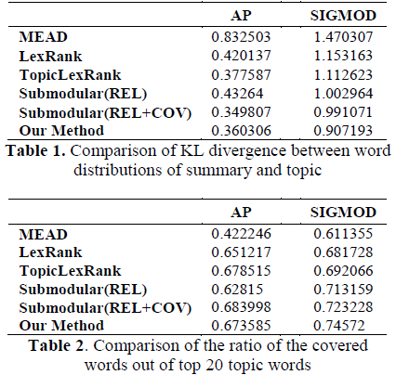
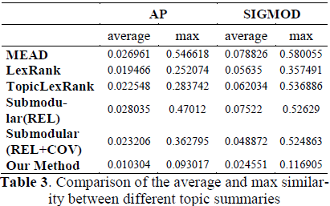
4
Experiments

Slide 10
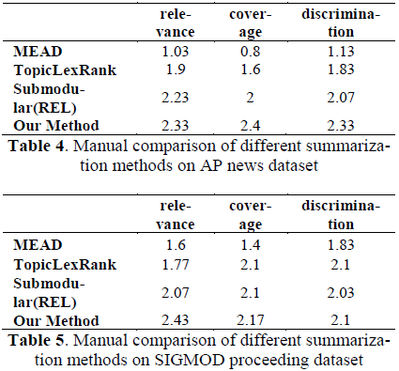
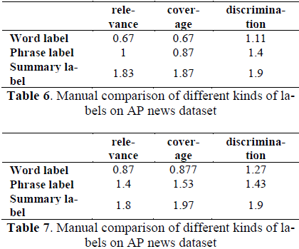
4
Experiments

Slide 11
5
Future work
Score function
Evaluation
Practical use
Make use of all the three kinds of labels together to improve the users’ experience

Slide 12
Topical Word Embeddings
2015 AAAI
12

Slide 13
1
Motivation
Each word have different embeddings under different topics
For example: the word apple indicates a fruit under the topic food, and indicates an IT company under the topic information technology (IT)

Slide 14
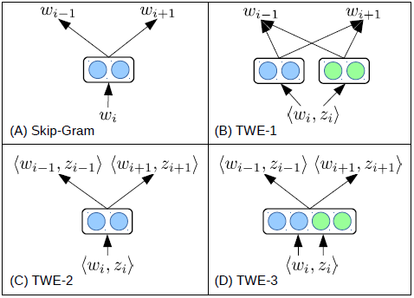
1
Motivation

Slide 15


2
Methods
Skip-Gram
The objective is to maximize the average log probability

Slide 16

2
Methods
TWE1
Regarding each topic as a pseudo word that appears in all positions of words assigned with this topic
Topical word embedding

Slide 17
2
Methods
TWE1
Document embedding
Pr(w | d) can be weighted with TFIDF scores of words in d

Slide 18


2
Methods
TWE2
Regarding each word-topic pair <w, z> as a pseudo word
Word embedding
Pr(z|w) can be obtained from LDA

Slide 19
2
Methods
TWE3

Slide 20
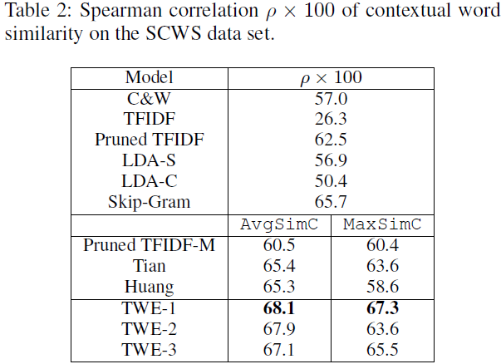
3
Experiments
Contextual Word Similarity

Slide 21
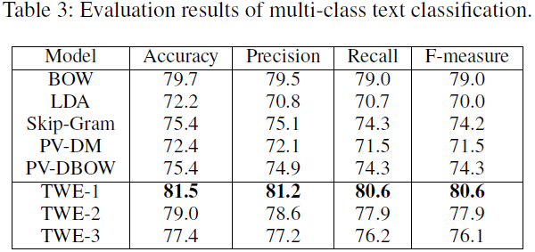
3
Experiments
Text Classification

Slide 22
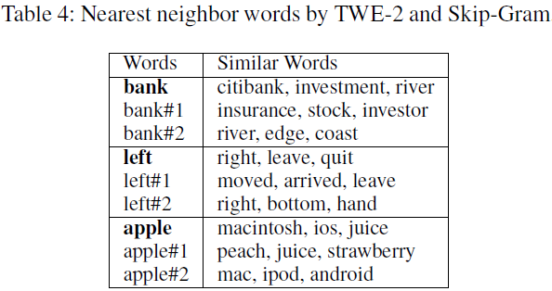
3
Experiments
Examples of Topical Word Embeddings

Slide 23
Improving short text classification by learning vector representations of both words and hidden topics
2016 Knowledge-Based Systems
23

Slide 24
1
Motivations
TWE models view topics as pseudo words to predict contextual words
This paper view topics as new words in the text

Slide 25
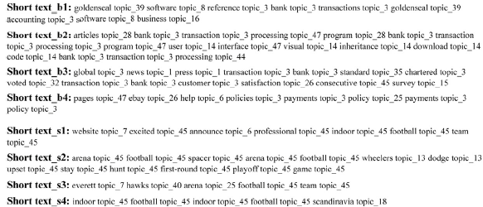
2
Methods
Enriching the short texts with hidden topics

Slide 26
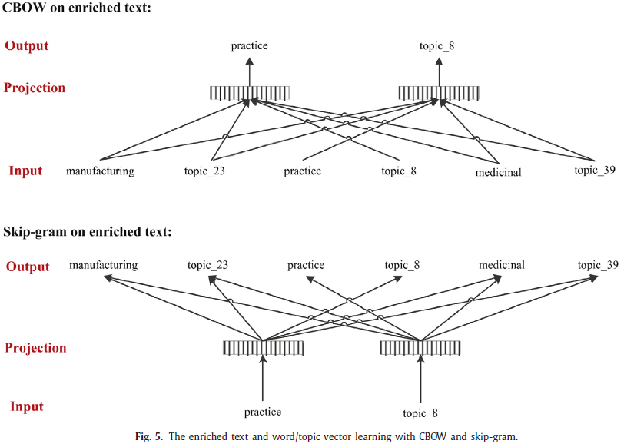
2
Methods

Slide 27
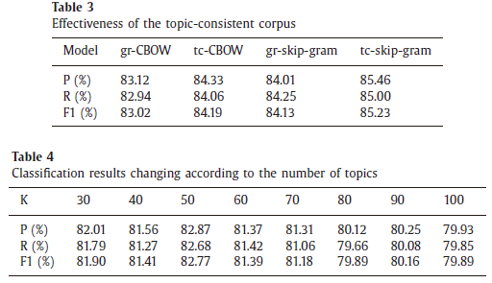
3
Experiments

Slide 28
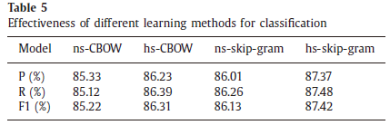
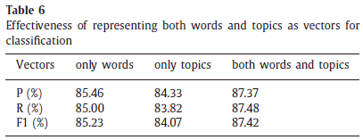
3
Experiments

Slide 29
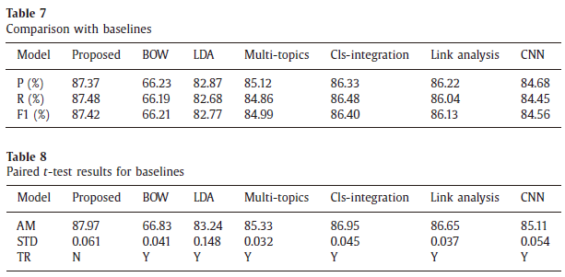
3
Experiments

Slide 30
3
Future work
Other topic models
categorical labels, hyperlinks and timestamps

